Slide 1
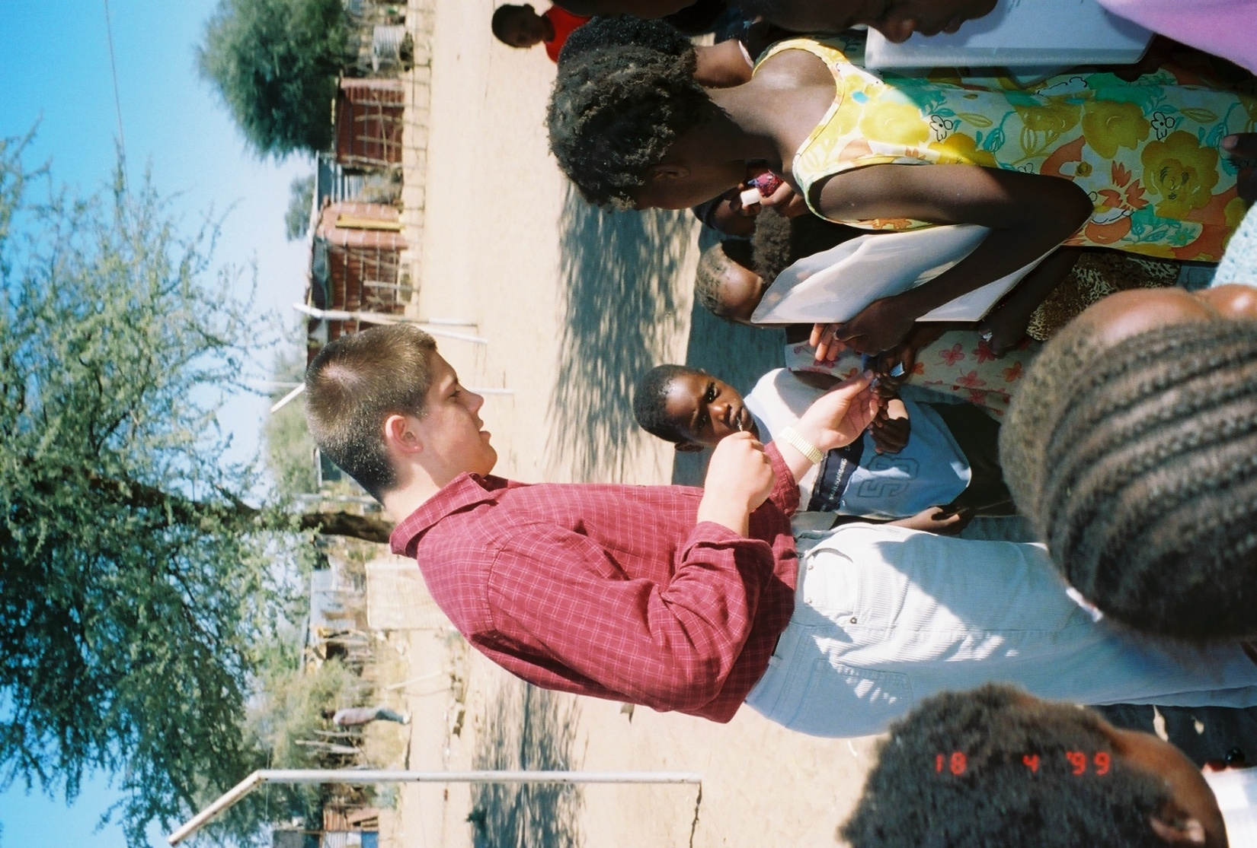
Five Realities of Relational Evangelism
Showing the Love of Jesus

Slide 2
Five Realities of relational evangelism
Farming principles have remained the same over the years.
Prepare, plant, cultivate, harvest, and invest for the next crop.
Relational evangelism enjoys some similarly great principles that we already do to some extent.
What is relational evangelism and how can you do it successfully?
It’s ok to make mistakes—journey of relational evangelism can be as rewarding as harvest time

Slide 3
Prepare – You need to build relationships
Many of us already enjoy building and nurturing relationships
Around our areas of work, play, and day-to-day activities. We all have relationships.
We tend to share the Gospel with a person we have built some level of relationship.
Over the years, I asked my evangelism students how many of them prefer the door-to-door, in your face, confrontational evangelism. ➔ONLY TWO STUDENTS!

Slide 4
Prepare – You need to build relationships
How do you build relationships for relational evangelism?
The same way you developed the friends you enjoy now.
Great relationships take time, commitment and intentionality—like relational evangelism!
Relational evangelism demands a more intentional pursuit of trusted relationships
May only see once or twice a week ➔Build friendships that last – saved or not

Slide 5
Prepare – You need to build relationships
Relational Evangelism may take years – just like my friend who took 35 years to accept Christ.
No matter how infrequent we talked – he knew he could always call…and cuss.
“The trick of delivering God’s mail to a person’s spiritual address is really no trick at all; it’s mostly a matter of caring enough to treat people with the kindness and respect we desire for ourselves.”
--Steve Sjogren, Dave Ping, & Doug Pollock, Irresistible Evangelism: Natural Ways to Open Others to Jesus (Loveland, CO: Group Publishing, 2004), 70.

Slide 6
Plant – Anybody Can Do Nothing
Matthew 28:19, “Therefore go and make disciples of all nations, baptizing them in the name of the Father and of the Son and of the Holy Spirit.”
Reveals the need for action because it tells us to “go,” to “make,” and to “baptize;”
People are watching our lifestyle and our example – others may eavesdrop on us!
My airplane experience – sometimes it is what we do not say that speaks the loudest!

Slide 7
Plant – Anybody Can Do Nothing
As Christians, we often see evangelism as either success or failure.
But God uses our “actions” as easily as our words of Scripture & reasoning to plant gospel seeds.
Our “actions speak louder than words”—especially in the Christian realm
Especially with non-Christians who often have preconceived ideas or stereotypes.

Slide 8
Plant – Anybody Can Do Nothing
God has called each of us to scatter seeds of faith, hope, and God’s love = THE GOSPEL.
God will do whatever else is needed if we will just allow God an opportunity to use us.
Knowing when not to share anything except God’s love may plant even more gospel seeds.

Slide 9
Cultivate Relationships When Opportunities Arise
Cultivating relationships means we have to work on educating ourselves and others
Trying to build trusted relationships with cynical people who have been hurt by the Church will demand lots of Godly love and patience.
Over time your non-judgmental attitude and desire to listen and help—as a friend—will eventually remove the barriers to more meaningful conversations.

Slide 10
Cultivate Relationships When Opportunities Arise
2. Cont.
People in the church long for a compassionate, loving touch from God
Sometimes, God uses common, everyday Christians to do just that.
Relational evangelism does not have to specifically target only unchurched people.
Even when seeds are scattered in good soil, healthy plants still need nurturing, by cultivating and removing weeds—as I found out long ago—in my own cornfield.

Slide 11
Harvest Time Takes Time
Waiting is the fourth and hardest reality of evangelism
NOTE: God did not ask you to “win” souls. He just asked you to plant seeds.
Steve Sjogren and evangelism author George G. Hunter III estimate that, “on average, it takes between twelve and twenty significant ‘gospel touches’ for people to move from the beginning of the scale into genuine relationships with Christ.”

Slide 12
Harvest Time Takes Time
You have to earn the right to speak into someone’s life on a deep spiritual level.
Don’t assume that making a decision as serious and life changing as inviting Jesus Christ into your life can be accomplished in an initial fifteen- or twenty-minute presentation.

Slide 13
Harvest Time Takes Time
Christians must prepare themselves to share the Gospel in hopes that they may be the last link in the series of spiritual encounters a person faces, and realize that time is a significant part of that process.
God alone reserves the miracle of conversion and regeneration to himself.
With relational evangelism time is a reality you must embrace…➔Like links in a chain

Slide 14
Invest In Yourself
One more reality awaits us if we truly desire effectiveness in relational evangelism.
Relational Evangelism flows out of your relationship with Christ
So it makes sense for us to invest in our own spiritual wellbeing.
A person’s Christlikeness will attract other people!

Slide 15
Invest In Yourself
This fifth and final reality of relational evangelism is almost more important than all the others.
We must invest in our spiritual formation with a strategic plan of spiritual disciplines.
Dallas Willard, discussing the contrast between human and Christian spiritual formation, said: “Christian spiritual formation, in contrast, is the redemptive process of forming the inner human world so that it takes on the character of the inner being of Christ himself.”
Involves fasting, Scripture memorization and prayer.

Slide 16
Invest In Yourself
Mandatory reflection and prayer arise as two of the greatest benefits to spiritual “planning.”
Regularly spend time in prayerful reflection to help you gain the spiritual awareness
Spiritual disciplines involve every aspect of your life = so assess periodically
Effective spiritual disciplines can involve: quality family times; fun times; Christian friends; personal acquaintances and even our secular jobs.
Let the Holy Spirit guide you!

Slide 17
Conclusion
Church leaders and disciplers often talk about the many excuses and fears that prevail in evangelism, but every Christian needs to remember, “winning the world to Jesus Christ begins with one soul at a time.”
Relational evangelism is about building relationships, planting seeds, cultivating opportunities, embracing time and investing in yourself.

Slide 18
Conclusion
But one reality stands above all others—you cannot judge yourself in evangelism as a success or failure. So pick up your bag of gospel seed and start sowing seed wherever you go. There are people in your community who have been waiting to hear some Good News from someone they trust.

Slide 19
What You Can Do
Write down or share in a group at least one person you already know on a first name basis at a place you frequent every week for whom you could begin praying. This can include anyone from airport staff to the staff at your favorite restaurant—or even the local hardware store or coffee shop workers. Where to you go each week?

Slide 20
What You Can Do
Think about or discuss with your group these places you routinely visit and how you might build relationships with people there. Bank tellers, grocery store cashiers, Post Office employees, students or teachers at schools, retail store employees, and peers at work are some of the type of people with whom great relationships can be nurtured!

Slide 21
What You Can Do
Write down or share in a group unpleasant evangelism situations you may have had that you thought were total failures. What positive aspects of those experiences can you or your group see that may help reveal what God might have done in spite of your efforts?

Slide 22
What You Can Do
Mark Mittelberg mentions having three people for whom you readily pray concerning faith in Christ. Make your own list right now of three people you know.
___________________________________________
___________________________________________
___________________________________________
Bill Hybels and Mark Mittelberg, Becoming A Contagious Christian (Grand Rapids, MI: Zondervan, 1994), 104.

Slide 23
What You Can Do
Share how you would translate the following verse in the King James translation of Scripture into more modern language so that non-churched people might understand.
John 3:16, “For God so loved the world, that He gave His only begotten Son, that whosoever believeth in Him should not perish, but have everlasting life.”

